Slide 1
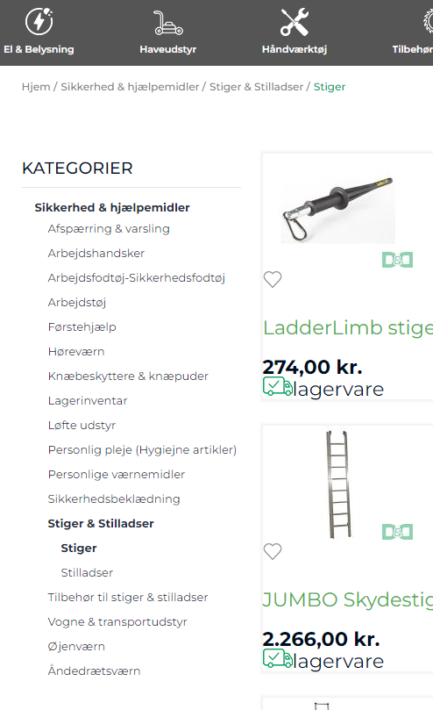
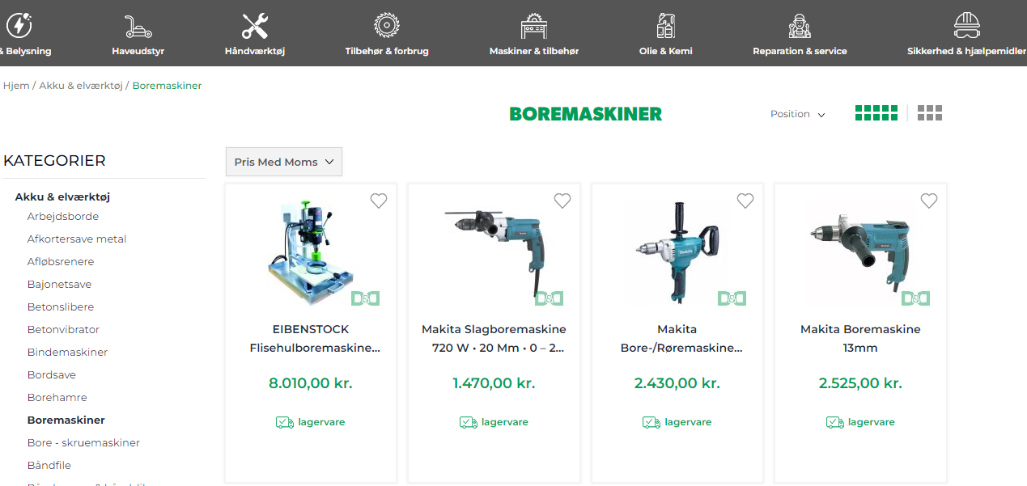
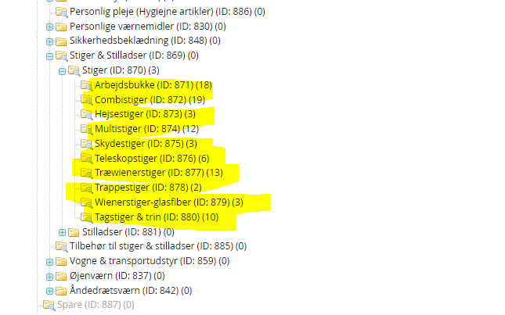
3nd level catagorie shall be show on the top
This has a 3nd level sub catagories it shall show i the left nav and in a bare on the like this design like this if this are more what we can show make a scroll and if more a hafe blok like this

Slide 2
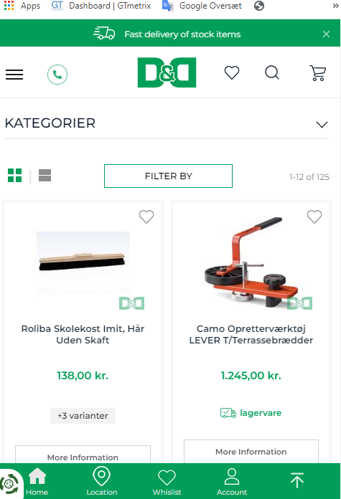
Same for mobil

Slide 3
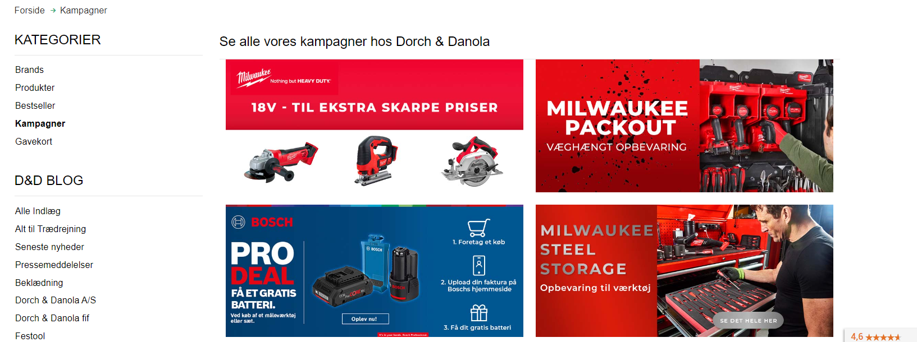
Kampange banner / pages today https://www.dorchdanola.dk/kampagner.html
Click on this banner to goto to campaig page.

Slide 4
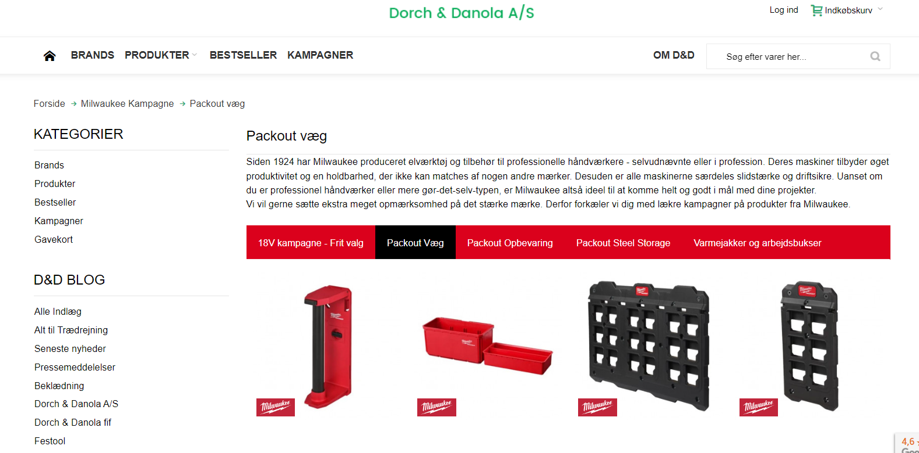
Campaign banner / pagesShould it work as it does today, can FME do something that allows us to show the campaign on our new page? https://www.dorchdanola.dk/milwaukee-kampagne/packout-vaeg.html
Note there can in a campaign
be show a menu in the campaign page

